Slide 1
Probabilistic programming Day 2
Sampling - Markov chains – MonteCarlo – Metropolis – Bootstrap – Bayesian Regression – Classification - More PyMC3

Slide 2
Recap
Third way between ML (big data, black box) and Stats (Hypothesis and tests)
Probabilistic programming = Bayes + Sampling
Beta – Binomial conjugate prior
Coin flipping – Dice rolling – polls
=> Distribution instead of point estimates

Slide 3
Today
Bootstrapping the Poisson
Many ways to sample
Markov chains & MCMC
Bayesian Linear regression
Bayesian Logistic regression

Slide 4
Boostraping the poisson

Slide 5
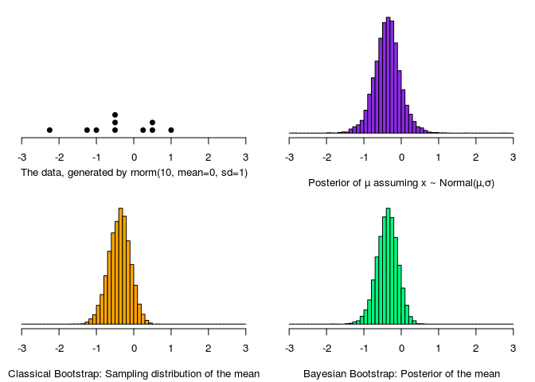
Distribution by sampling: Bootstrap!
From a small number of samples, sample with replacement to obtain the distribution of the random variable
Powerful!
Notes:
Faire un exemple notebook

Slide 6
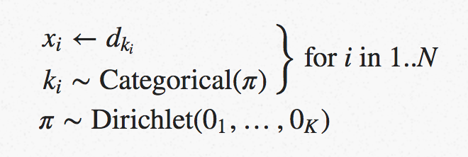
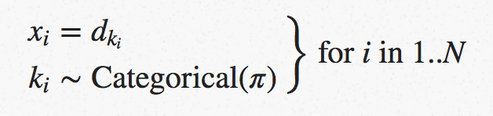
The Non-parametric Bootstrap as a Bayesian Model
Boostrapping as a simplified version of MCMC (in a way): http://www.sumsar.net/blog/2015/04/the-non-parametric-bootstrap-as-a-bayesian-model/

Slide 7
Poisson
the Poisson distribution named after French mathematician Siméon Denis Poisson, is a discrete probability distribution that expresses the probability of a given number of events occurring in a fixed interval of time or space if these events occur with a known constant rate and independently of the time since the last event.
la loi de Poisson est une loi de probabilité discrète qui décrit le comportement du nombre d'événements se produisant dans un intervalle de temps fixé, si ces événements se produisent avec une fréquence moyenne ou espérance connue et indépendamment du temps écoulé depuis l'événement précédent.

Slide 8
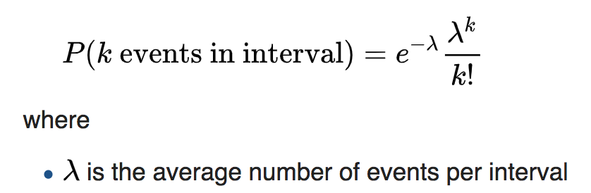
Poisson
Exemple:
The number of meteorites greater than 1 meter diameter that strike Earth in a year
The number of patients arriving in an emergency room between 10 and 11 pm
The number of photons hitting a detector in a particular time interval
Incoming calls to a call center
Number of server failures in a data center

Slide 9
Poisson Bootstrap vs Bayesian Inference demo
Generate data ~ Poisson(Lambda), size = n
Compare:
Simple mean
Bootstrap
PyMC3
vary n, observe accuracy
lambda_ = 5
data = st.poisson.rvs(lambda_, size =20)
plt.hist(data)

Slide 10
Sampling
why? how?

Slide 11
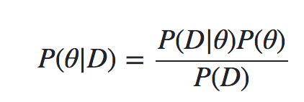
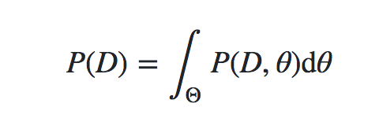
Why sampling?
Conjugate priors do not scale
Hierarchical models have hundreds of parameters
=> impossible to derive analytical expression
Bayes formula requires to integrate over space of all parameters to estimate the denominator
=> curse of dimensionnality

Slide 12
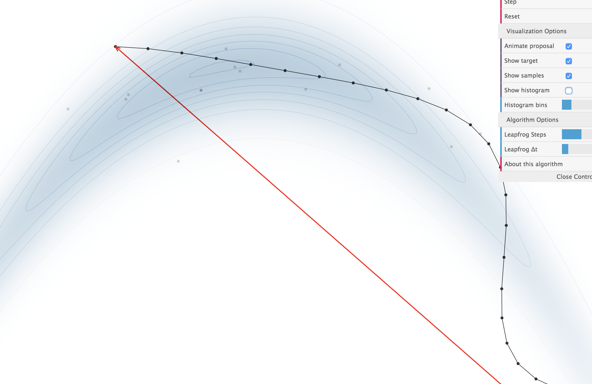
Sampling demo
https://chi-feng.github.io/mcmc-demo/

Slide 13

Sampling
approximation of any high dimensional integral.
Family of algorithms
Metropolis-Hastings,
Gibbs Sampler,
Hamiltonian MCMC
No-U-Turn Sampler (NUTS)
Monte Carlo: Random search
Markov chains: jumping around without dependence on the starting point

Slide 14
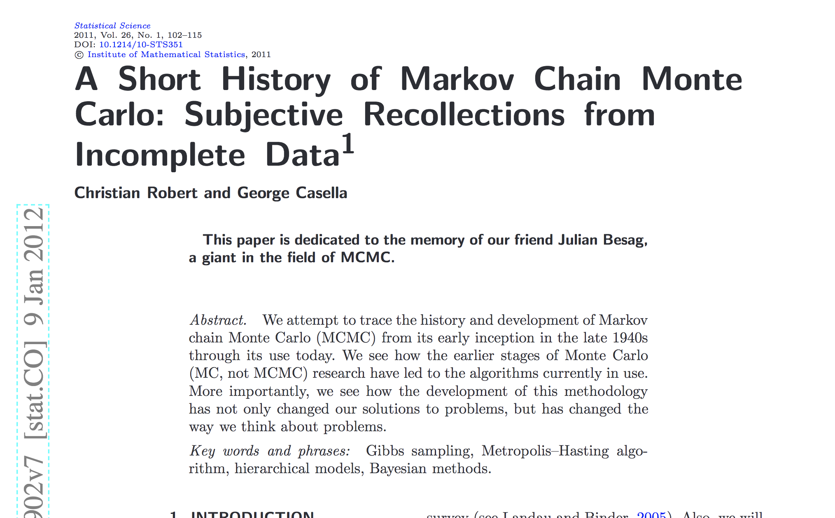
A Short History of Markov Chain Monte Carlo
A Short History of Markov Chain MonteCarlo 2011 0808.2902.pdf

Slide 15
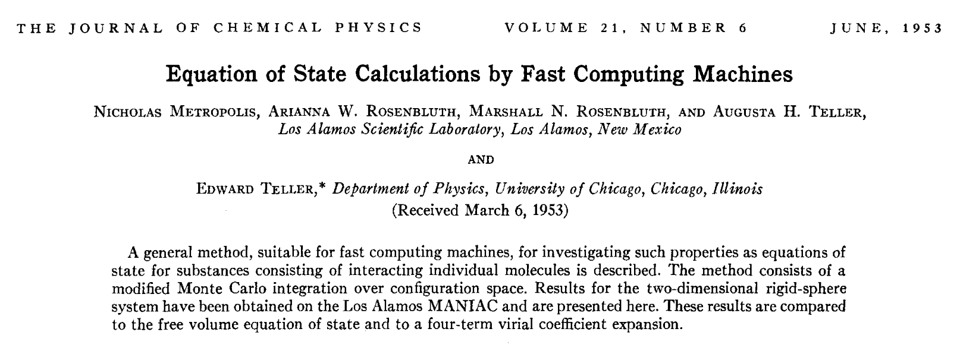
Metropolis Hastings Algo 1953

Slide 16
MCMC
Monte Carlo + Markov Chain

Slide 17
approximate the posterior distribution
sample from the posterior distribution by combining a "random search" (the Monte Carlo aspect) with a mechanism for intelligently "jumping" around, but in a manner that ultimately doesn't depend on where we started
from (the Markov Chain aspect).
Hence Markov Chain Monte Carlo methods are memoryless searches performed with intelligent jumps.
Need to numerically evaluate an integral in a potentially very large dimensional space

Slide 18
MCMC en pratique
The main difference between MCMC algorithms occurs in how you jump as well as how you decide whether to jump.
The Metropolis algorithm uses a normal distribution to propose a jump. This normal distribution has a mean value μ which is equal to the current position and takes a "proposal width" for its standard deviation σ.
proposal width :
larger => more exploration,
smaller takes longer to converge, might miss whole regions
Metropolis Algorithm
Begin the algorithm at the current position in parameter space (θ_current)
Propose a "jump" to a new position in parameter space (θ_new)
Accept or reject the jump probabilistically using the prior information and available data
If the jump is accepted, move to the new position and return to step 1
If the jump is rejected, stay where you are and return to step 1
After a set number of jumps have occurred, return all of the accepted positions => trace
https://www.quantstart.com/articles/Markov-Chain-Monte-Carlo-for-Bayesian-Inference-The-Metropolis-Algorithm

Slide 19
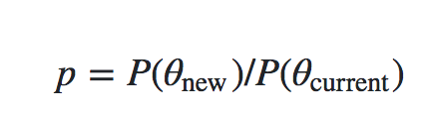
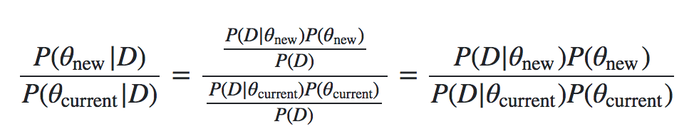
Acception criteria
Calculate ratio of probability current point vs probability previous point => p
Generate random number a in [0,1]
if a < p => accept else reject
depends only on the likelihoods and the priors
no longer on P(D)

Slide 20
MCMC Implementation
See:
http://twiecki.github.io/blog/2015/11/10/mcmc-sampling/
notebook https://github.com/twiecki/WhileMyMCMCGentlySamples/blob/master/content/downloads/notebooks/MCMC-sampling-for-dummies.ipynb
the trace (list of all accepted samples)
Look at autocorrelation to see if the samples are correlated
small jump size: large autocorrelation
need for a burn-in period to reduce influence of start area

Slide 21
Why does Metropolis-Hastings work?
http://people.duke.edu/~ccc14/sta-663-bootstrap/MCMC.html#why-does-metropolis-hastings-work
The samples generated by MCMC constitute a Markov Chain
This markov chain has a unique Stationary Distribution π
π is reached when generating large number of samples
The π distribution is the unique posterior distribution
Et voila!

Slide 22
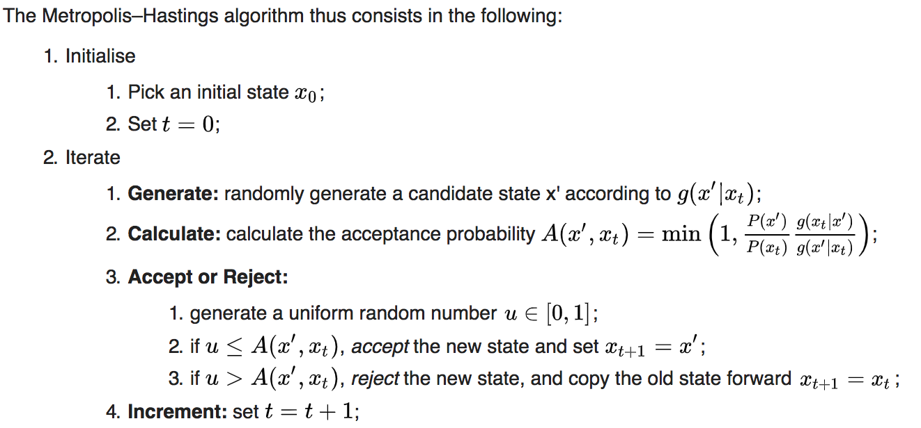
Metropolis-Hastings

Slide 23
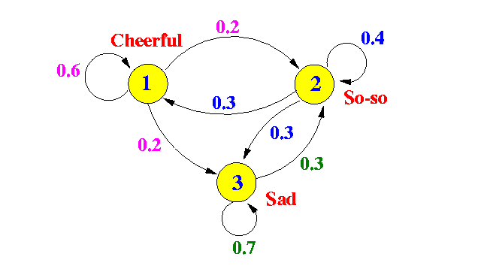
Markov chain = random walk
For a long enough random walk, the probability of ending on a given state is independent or where you started
These state long term probabilities constitute the distribution of the markov chain

Slide 24
For a Markov Chain Transition Matrix P: π = πP
P_i,j = P( x_t = i / x_(t-1) = j )
π is a stationary distribution iif
Irreducible: posssible to go from any state to any other state
Mixing, aperiodic: no oscillation
Positive recurrence:
from any state, the time to go back to that state is finite. ⬄ P(returning to any state) = 1
⬄ The system converges to an equilibrium state

Slide 25
Acceptance criteria
Define the transition probability matrix from state i to j as
P (i -> j) = min(1, p(j) / p(i) )
it can be shown that
P(i)P (i -> j) = P(j) P(j-> i)
⬄ P(i)P (j / i) = P(j) P(i/ j)
which implies that P is the posterior distribution

Slide 26
MCMC by Christopher Fonnesbeck
Christopher Fonnesbeck Probabilistic Programming with PyMC3 PyCon 2017
https://youtu.be/5TyvJ6jXHYE?t=1012
see also https://twiecki.io/blog/2014/01/02/visualizing-mcmc/
see http://people.duke.edu/~ccc14/sta-663-bootstrap/MCMC.html#why-does-metropolis-hastings-work
https://jeremykun.com/2015/04/06/markov-chain-monte-carlo-without-all-the-bullshit/

Slide 27
MCMC implementation
in a few lines of python we're going to implement MCMC sampling of a posterior distribution
Data ~ N(mu,1)
P(mu /D) = p( D/ mu ) P(mu) / P(D)
we want to find mu knowing D the data
assume data follows a N(mu, sd) with mu unknown and sd = 1 => likelihood is Normal
Then the likelihood: p( D/ mu ) ~ N(mu, sd) # based on data
prior: p(mu) ~ N(0,1) # our choice

Slide 28
Bayesian Linear regression

Slide 29
Freq vs Bayes
OLS regression
Probability of obtaining the data if the null hypothesis is true: p(D|Ho)
Unfortunately, p(Ho|D) != p(D|Ho)
"a test of statistical significance "does not tell us what we want to know, and we so much want to know what we want to know that, out of desperation, we nevertheless believe that it does!"
Cohen, J. (1994). The earth is round (p < 0.05). American Psychologist, 49, 997-1003.

Slide 30
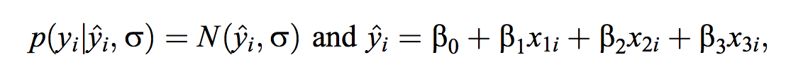
likelihood / linear regression

Slide 31
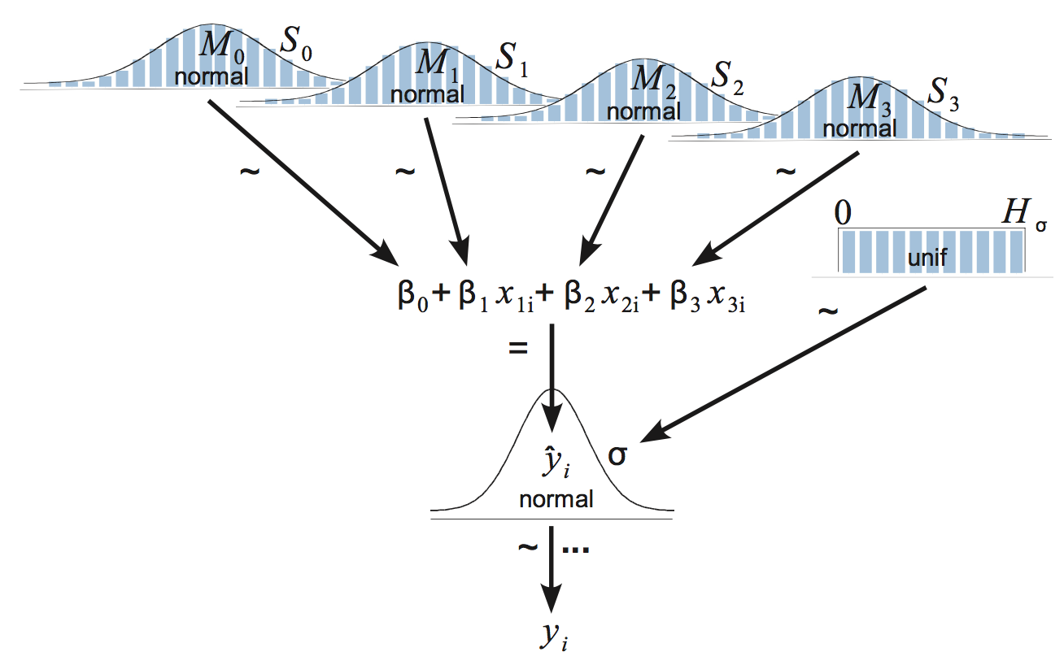
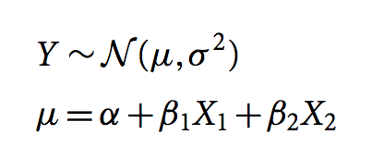
Bayesian linear regression

Slide 32
Estimating parameters of a linear regression model
http://people.duke.edu/~ccc14/sta-663-bootstrap/PyMC3.html#estimating-parameters-of-a-linear-regreession-model

Slide 33
GLM
Alternative formulation using GLM formulas
http://people.duke.edu/~ccc14/sta-663-bootstrap/PyMC3.html#alternative-fromulation-using-glm-formulas

Slide 34
Application to Ozone
Linear regression

Slide 35
Ozone dataset
Temp = f(Ozone, Wind, Solar)
Temp = a + b * Ozone + e
Temp ~ N(mu, sigma)
mu ~ N(0,10), sigma ~ HalfN(0,1)
Statsmodel OLS
2 predictors Temp = f(Ozone, Wind)
normalize, diff coef
Use Student-t to model Temp
glm model in PyMC3

Slide 36
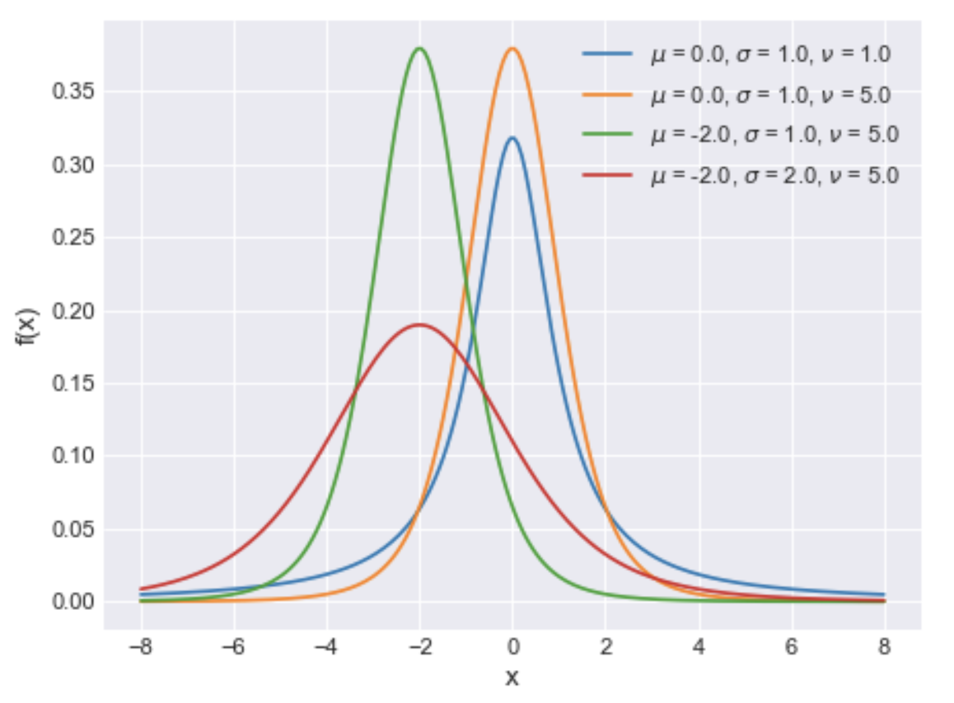
Student-T distribution
https://docs.pymc.io/api/distributions/continuous.html#pymc3.distributions.continuous.StudentT
 | nu : float Degrees of freedom, also known as normality parameter (nu > 0). mu : float Location parameter. sd : float Scale parameter (sd > 0). Converges to the standard deviation as nu increases. (only required if lam is not specified)

Slide 37
Logistic regression
Iris?

Slide 38
Binary classification
Likelihood : Ber(p):
pm.Bernoulli( 'observed' , p, observed = y)
with p ~ Logit( a + b_i . X )
pm.Deterministic( 'p', 1 / ( 1 + pm.math.exp( -mu ) ) )
mu = a + pm.math.dot(x,b)
and
a ~ N(mu,sd)
b_i ~ N(mu,sd, i)
Exercise:
generalize to multinomial classification

Slide 39
Predict
how to?

Slide 40
Reuse the parameters
alpha_pred = trace['alpha'].mean()
betas_pred = trace['betas'].mean(axis=0)
y_pred = alpha_pred + np.dot(betas_pred, X_tr.T)

Slide 41
Posterior Predictive Checks
Generate data from the model using parameters from draws from the posterior.
PPCs analyze the degree to which data generated from the model deviate from data generated from the true distribution.
https://docs.pymc.io/notebooks/posterior_predictive.html

Slide 42
Optimize
MAP, posterior predictive checks

Slide 43
pymc3.plots
forest plot, posteriori plot, …

Slide 44
Model Comparison
# Model comparison
https://pymc3.readthedocs.io/en/stable/notebooks/model_comparison.html

Slide 45
Model debugging
# How to debug a model
https://github.com/pymc-devs/pymc3/blob/master/docs/source/notebooks/howto_debugging.ipynb

Slide 46
WAIC – comparison, model selection
pm.stats.waic(model=models_lin['k1'], trace=traces_lin['k1'])
We should prefer the model(s) with lower WAIC
Watanabe - Akaike Information Criterion (WAIC) is another simple option for calculating the goodness-of-fit of amodel
https://docs.pymc.io/api/stats.html
pm.stats.loo(trace_t, model_t)
Compare

Slide 47
Maximum a posteriori methods
The maximum a posteriori (MAP) estimate for a model, is the mode of the posterior distribution and is generally found using numerical optimization methods.
This is often fast and easy to do, but only gives a point estimate for the parameters and can be misleading if the mode isn’t representative of the distribution.
PyMC3 provides this functionality with the find_MAP function.
find_MAP uses the Broyden–Fletcher–Goldfarb–Shanno (BFGS) optimization algorithm to find the maximum of the log-posterior
the MAP estimate is not always reasonable, especially if the mode is at an extreme.
This can be a subtle issue; with high dimensional posteriors, one can have areas of extremely high density but low total probability because the volume is very small.

Slide 48
Posterior Predictive Checks
https://docs.pymc.io/notebooks/posterior_predictive.html
Samples N from trace => mu, sigma
Then draw M samples from Normal distribution generated by those parameters

Slide 49
Sampler stats
When checking for convergence or when debugging a badly behaving sampler, it is often helpful to take a closer look at what the sampler is doing. For this purpose some samplers export statistics for each generated sample.
https://pymc3.readthedocs.io/en/stable/notebooks/sampler-stats.html

Slide 50
GLM

Slide 51
Generalized Linear Models
https://docs.pymc.io/notebooks/getting_started#Generalized-Linear-Models
check # Alternative formulation using GLM formulas¶
http://people.duke.edu/~ccc14/sta-663-bootstrap/PyMC3.html#alternative-fromulation-using-glm-formulas
https://docs.pymc.io/notebooks/GLM-robust-with-outlier-detection.html#Create-Robust-Model:-Student-T-Method

Slide 52
Ordinary Least Squares Regression with PyMC3 in https://blog.applied.ai/bayesian-inference-with-pymc3-part-1/

Slide 53
Resources and tutorials
Bayesian Linear Regression in Python: Using Machine Learning to Predict Student Grades https://towardsdatascience.com/bayesian-linear-regression-in-python-using-machine-learning-to-predict-student-grades-part-2-b72059a8ac7e

Slide 54
Further reading
A Beginner's Guide to Markov Chain Monte Carlo, Machine Learning & Markov Blankets https://skymind.ai/wiki/markov-chain-monte-carlo
A Zero-Math Introduction to Markov Chain Monte Carlo Methods https://towardsdatascience.com/a-zero-math-introduction-to-markov-chain-monte-carlo-methods-dcba889e0c50
Bayesian logit model - intuitive explanation? https://stats.stackexchange.com/questions/163034/bayesian-logit-model-intuitive-explanation
Bayes regression: how is it done in comparison to standard regression? https://stats.stackexchange.com/questions/252577/bayes-regression-how-is-it-done-in-comparison-to-standard-regression

